Slide 1
Machine Learning
Module 1: Additional Material
Atul Kahate
(https://www.linkedin.com/in/atulkahate/)

Slide 2
Feature Selection Methods
Filter methods (Before the model is built)
  Correlation coefficient
  Chi-square test
  Variance threshold
Wrapper methods (After the model is built)
  Forward selection
  Backward selection
  Recursive feature elimination
Embedded methods (During the model building)
  LASSO (L1 Regularization)
  Decision tree
  Elastic net

Slide 3
Filter Methods
Method | What it does | Data Type | Example
Correlation Coefficient | Measures linear relationship between feature and target | Numerical | In house price prediction, remove one of area or number_of_rooms if both are highly correlated
Chi-Square Test | Tests dependency between feature and target | Categorical | In spam detection, test if word “free” is dependent on spam/not-spam
Variance Threshold | Removes features with very low variance | Any | In sensor data, remove sensors that show almost constant readings

Slide 4
Wrapper Methods
Method | How it works | Model Used | Example
Forward Selection | Starts with no features and adds one at a time | Any ML model | In student performance prediction, start with attendance, then add study_hours, then previous_scores
Backward Elimination | Starts with all features and removes least useful | Regression / Classification | In medical diagnosis, remove least impactful test results step-by-step
Recursive Feature Elimination (RFE) | Recursively removes least important features | Linear / Tree models | In text classification, remove least important TF-IDF words iteratively

Slide 5
Embedded Methods
Method | How it selects features | Model Type | Example
LASSO (L1 Regularization) | Forces some coefficients to zero | Linear Regression | In salary prediction, LASSO drops irrelevant features like employee_id
Decision Tree Feature Importance | Selects features used in splits | Tree-based models | In loan approval, tree selects credit_score over zip_code
Elastic Net | Combines L1 + L2 regularization | Linear models | In gene expression data, handles correlated genes effectively

Slide 6
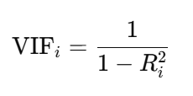
Handling Multicollinearity
Multicollinearity: Two or more input features are strongly correlated with each other
Example: House size in square feet and Number of rooms
Usually increase together -> High correlation
Problem: Model gets confused about which one is more important
Variance Inflation Factor (VIF): Measures how much a feature is explained by other features
  Tells us: Is this feature important or redundant?
Here, R_{i}² = R² is when feature i is predicted using all other features
Each feature will get its own VIF value

Slide 7
VIF Calculation Step-by-Step
For each feature x_{i}
  Treat x_{i} as the target
  Use all the other features as predictors
  Compute R²
  Plug this R² into VIF formula
VIF Value | Meaning
VIF = 1 | No correlation
1 < VIF < 5 | Moderate correlation
VIF > 5 | High multicollinearity (problem)

Slide 8
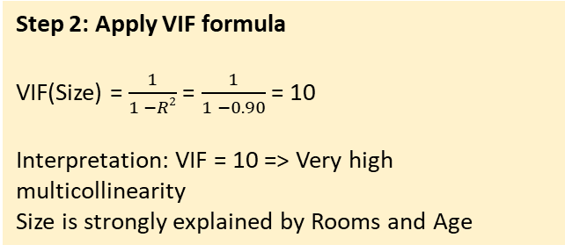
VIF Example
Observation | X₁ (Size) | X₂ (Rooms) | X₃ (Age)
1 | 100 | 2 | 10
2 | 120 | 3 | 12
3 | 140 | 3 | 14
4 | 160 | 4 | 16
5 | 180 | 5 | 18
Step 3: Repeat for other features
Suppose we get VIF(Rooms) = 6.67 and VIF (Age) = 1.25
Step 1: Choose a feature (say X₁ = Size)
To compute VIF(Size)
Use Rooms and Age to predict Size
Compute R² for the regression, suppose = 0.90
Feature | R² with other features | VIF | Meaning
Size | 0.90 | 10.0 | Highly correlated ❌
Rooms | 0.85 | 6.67 | Highly correlated ❌
Age | 0.20 | 1.25 | Safe ✔️
Step 2: Apply VIF formula
VIF(Size) = $\frac{1}{1 −R2}$ = $\frac{1}{1 −0.90}$ = 10
Interpretation: VIF = 10 => Very high multicollinearity
Size is strongly explained by Rooms and Age
Final conclusion
Problematic features: Size, Rooms
Safe feature: Age
Action: Remove either Size or Rooms (not both)

Slide 9
Log Transformation
Logarithm (log): Answers the question – “How many times do I need to multiply a base number to get another number?”
log_{b} (x) = y means b^{y} = x … e.g. log₁₀ (100) = 2 because 10² = 100
Log = Inverse of exponentiation
Generally, base is taken as e ~ 2.718 (Above, we have taken it as 10)
Use: Big numbers grow too fast, log compresses them
Value | Raw | ln(value)
10 | 10 | 2.3
100 | 100 | 4.6
1000 | 1000 | 6.9
1,000,000 | 1,000,000 | 13.8

